Slide 1
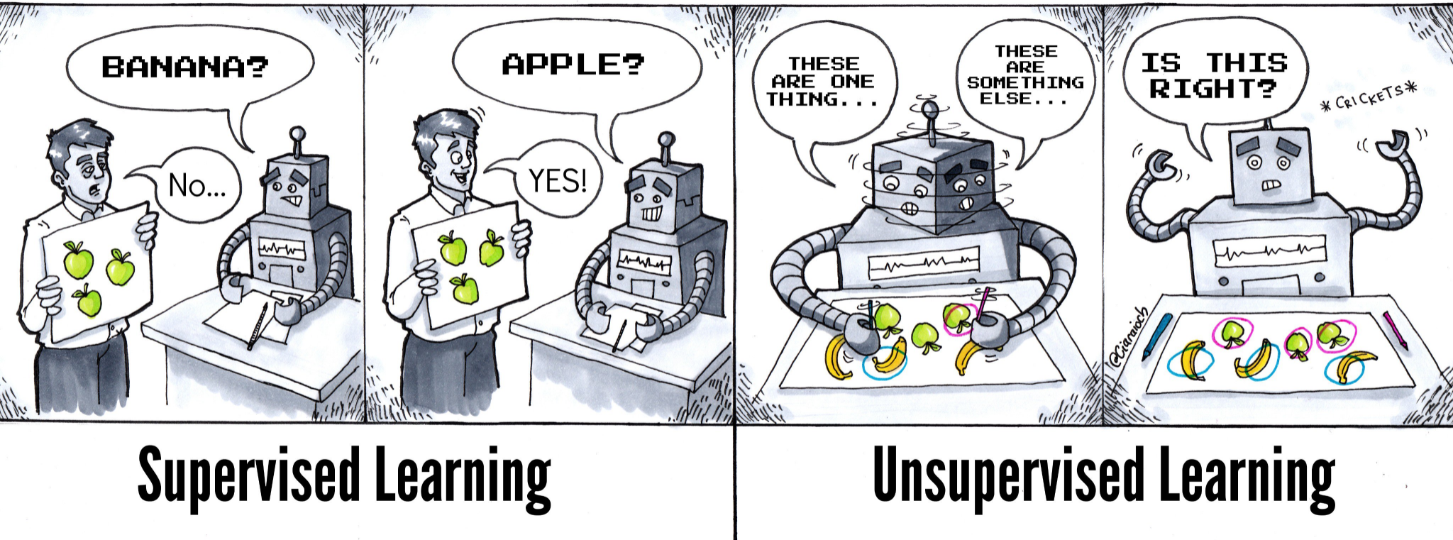
Source

Slide 2
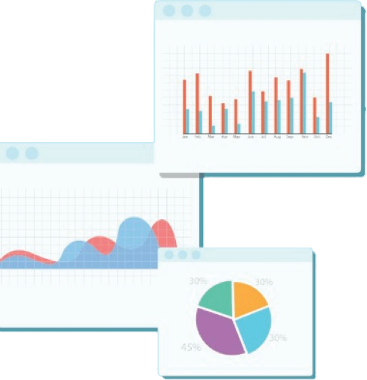

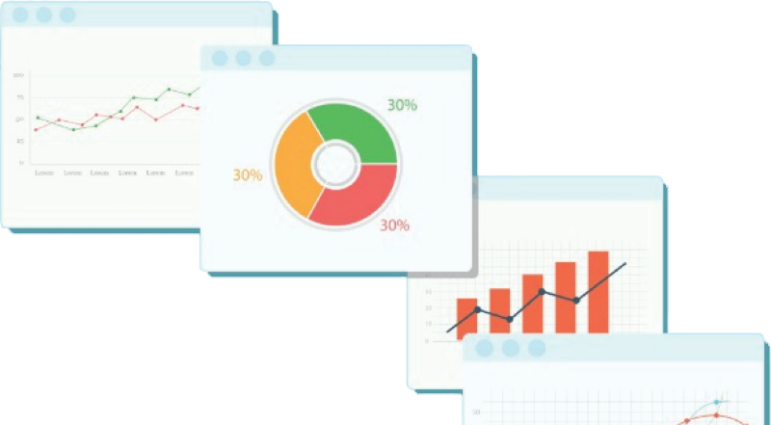
Welcome to Week 9
Lecture 1!
Data Science in Python &
Machine Learning

Slide 3
Announcements:
First week assignments are due until Sunday night.
All the following week assignments are due Friday morning 9AM (PST)
Belt Exams are in third week of stack
Belt Exam eligibility
- Completion of week 9 assignments including resubmits , and week 10 assignments

Slide 4
Learning Goals
After this lesson you will be able to:
Explain how supervised and unsupervised learning is different.
Cluster data using the K Means clustering algorithm.
Evaluate the clusters predicted by the K Means clustering algorithm using two different metrics.
Analyze clusters to discover insights about data.

Slide 5
Machine Learning
Supervised Learning
Unsupervised Learning

Slide 6
Machine Learning
Supervised Learning
Unsupervised Learning
Classification
Regression
Clustering
Dimensionality Reduction

Slide 7
Machine Learning
Supervised Learning
Unsupervised Learning
Clustering
Dimensionality Reduction
You are here!

Slide 8
Supervised or Unsupervised?
Unsupervised vs. supervised learning methods is based on the type of problem you are trying to solve.
One is not better than the other, they just address different questions.
With unsupervised learning, you do not have a target variable you are trying to predict.
Unsupervised learning finds patterns in data.
y

Slide 9
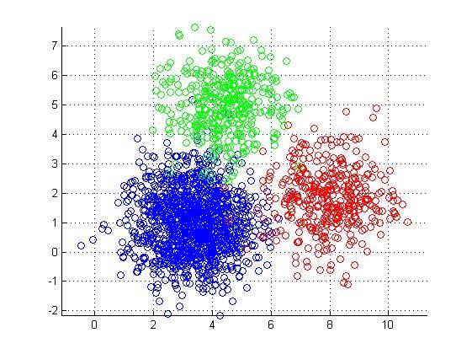
Unsupervised Learning- Clustering
Clustering is a way of grouping your data
Consider this example:
You have data set that has information about your customers.
Clustering would allow you to group your customers.
This helps the sales team better address the needs of each of these groups.
As a new customer is added, they can be assigned the appropriate group (and immediately receive the marketing email designed for their group).

Slide 10
Understanding Your Data with Clusters
Today, we are going to take time to explore a data set with the assistance of Kmeans clustering
Clustering and data exploration go together and can be an iterative process.
One approach is to use subject matter expertise to explore combinations of features that you think will provide relevant clusters.
Clustering can be done on many features.
However, as we learn and visualize the process, it is often easiest to explore clusters in just two dimensions (two features).

Slide 11
Preprocessing for a clustering model
There is no target variable, so no defining of X and y
We do NOT do a train test split
We DO need to scale our data using standardscaler() before we fit our model

Slide 12
The “job” of the model is to find patterns and group the data into distinct “clusters”
Two aspects of clustering are:
Points in same cluster should be similar
Points in different groups should be different
For our mall data, we are looking to divide our customers into target groups that can be the focus of specialized marketing efforts

Slide 13
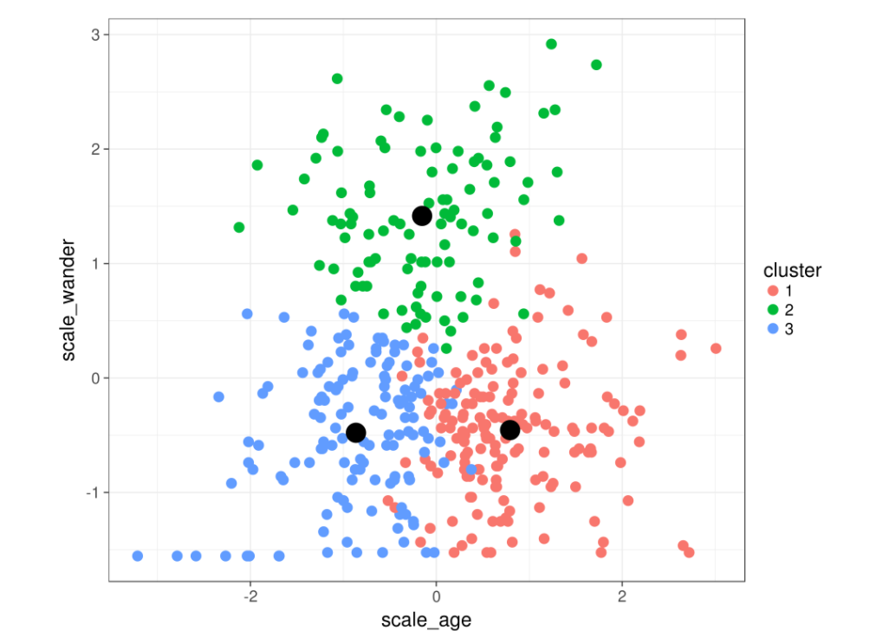
KMeans Clustering
k is the number of clusters
You will have to determine how many clusters as part of your tuning
The center of each cluster is called the centroid
Check the learn platform for an explanation of how these centroids are determined.
This visual shows a sample scatterplot based on 2 features and the clusters are color coded. This graph has a k of 3.
Source

Slide 14
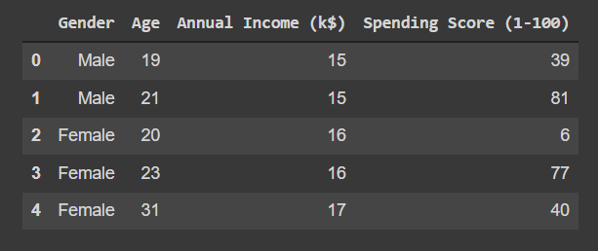
Challenge: Cluster Mall Customers
Cluster mall customers into similar groups
Explore those groups to understand what they are like
Colab Notebook

